Slide 1
Bronco Banking:
An ATM System
Group 3:
Mark Barros
Rosalinda Chamale
Anthony Zhang
Dexxer Medina
Anthony Sepulveda
CS 3560-03
Object-Oriented Design and Programming
Cal Poly Pomona – Spring 2021
Professor T. Damavandi

Slide 2

The Problem
Cal Poly students need a way to make basic transactions from the school’s bank while on campus.
Depositing Money
Withdrawing Money
Transferring Money
The bank operator needs a way to monitor things.
The Customers
The Accounts
The Transactions
This same problem exists in different contexts of course.

Slide 3
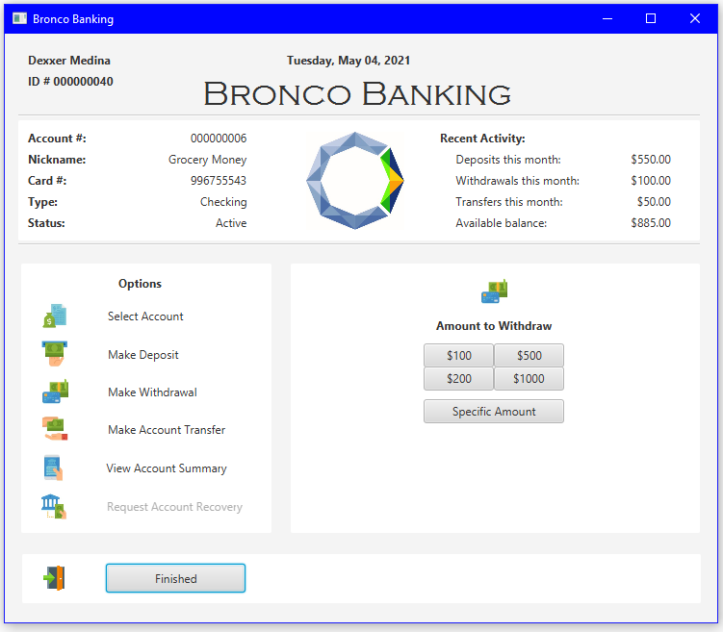
The Solution
The Bronco Banking ATM
System Capabilities:
View the current month’s transactions
View all transactions
Make deposits
Make withdrawals
Make transfers between accounts
Request account recovery

Slide 4
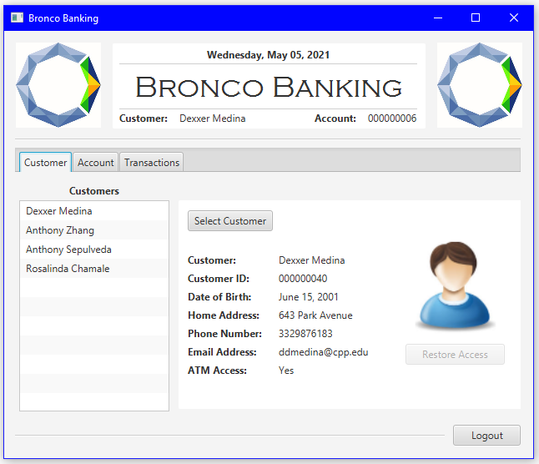
The Solution
The Bronco Banking ATM
System Capabilities:
View customer information
View customer accounts
View customer transactions
Restore customer access to the ATM
Freeze accounts
Recover accounts

Slide 5
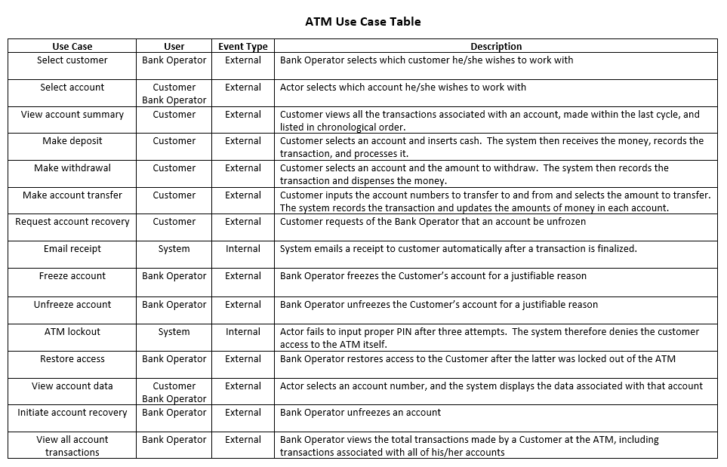
Use Cases
Actors:
Customer
Bank Clerk
System

Slide 6
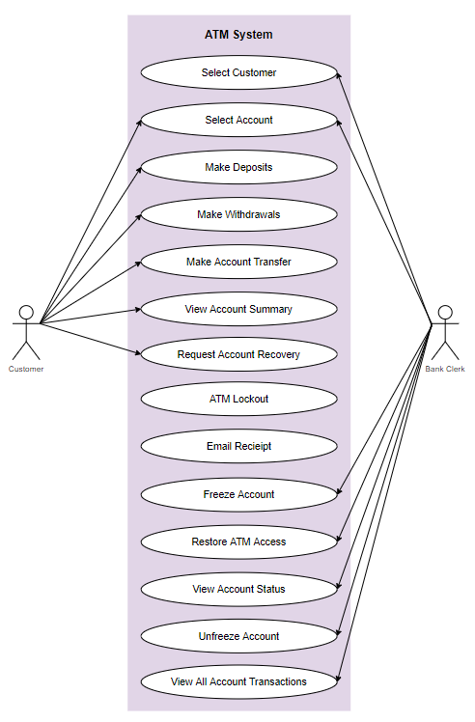
Use Cases Diagram
Actors:
Customer
Bank Clerk
System

Slide 7
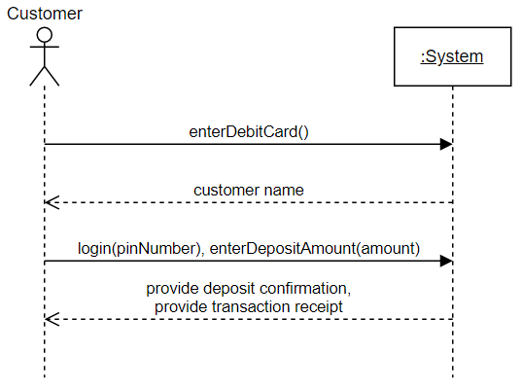
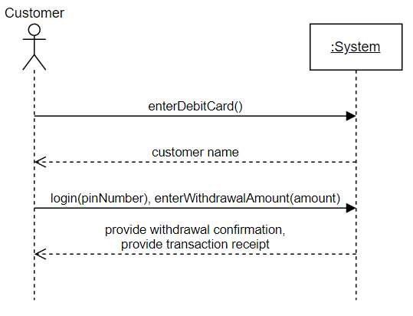
Deposits and Withdrawals SSDs

Slide 8
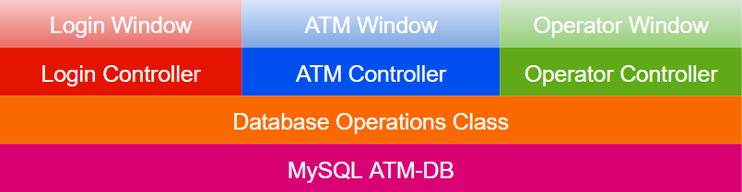
The Anatomy of the Bronco Banking System
The System has a Four Application Components:
UI Layer: The three windows and their sub-windows
Controller Layer: The controllers for the respective windows
DBMS Control Logic Layer: The database operations class
Data Layer: The ATM-DB schema

Slide 9
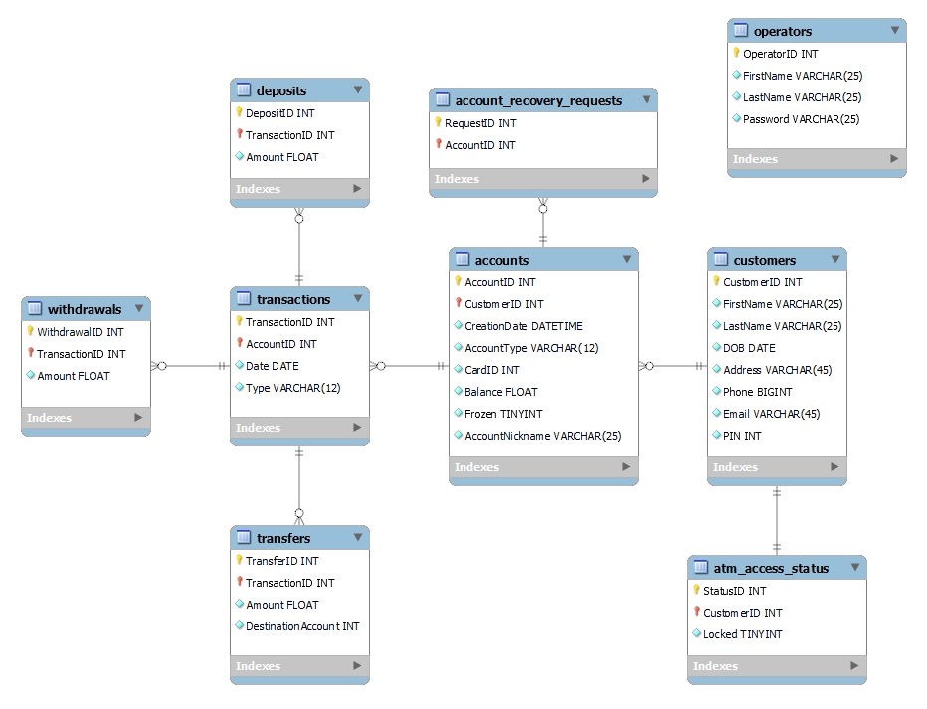
EER Diagram
During the design phase, we designed and implemented the database first.

Slide 10
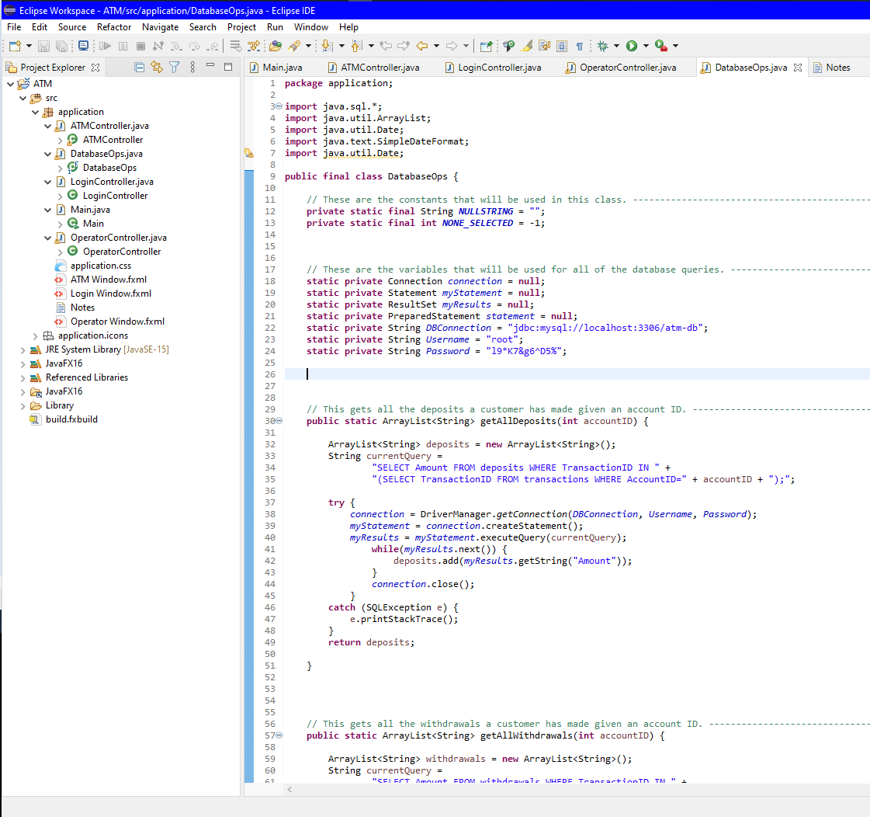
System
Organization
Windows
Controllers
Database Ops

Slide 11
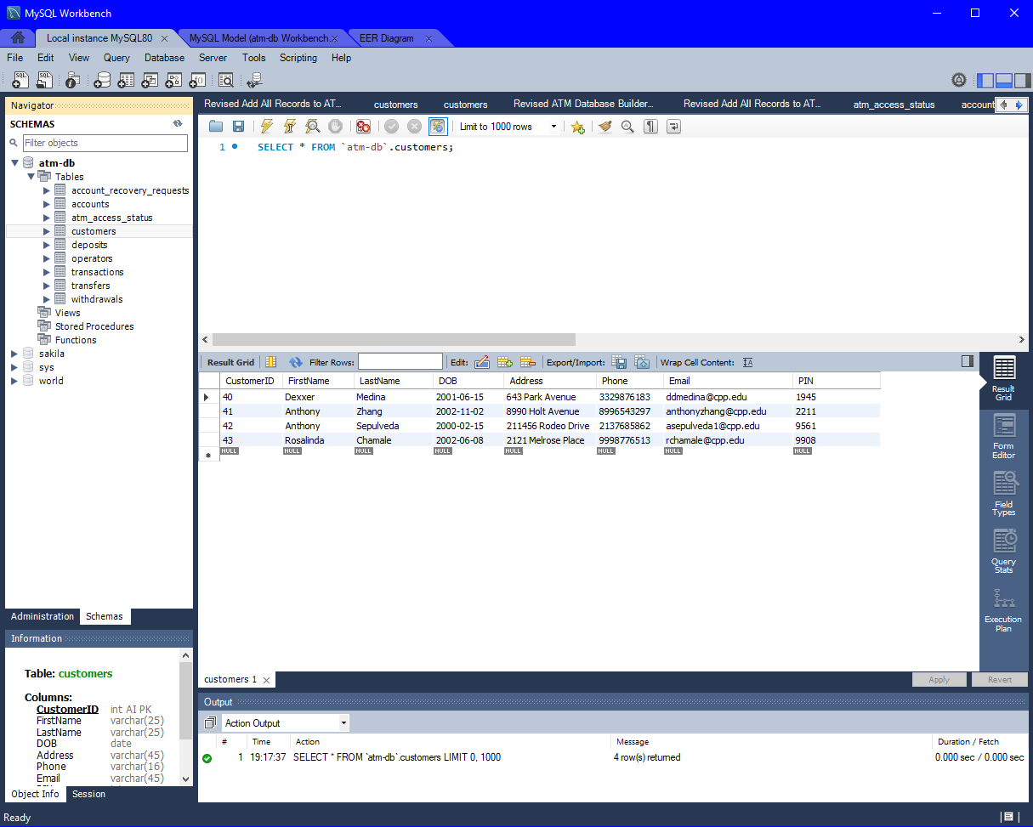
Schema
Design
Since at its core the ATM is a database, we focused a significant amount of time on its design.

Slide 12
Difficulties We Encountered
Lack of a centralized database
Minor changes to the database once in the coding stage
Misunderstanding about the difference between a frozen account and a denial of ATM access
Scope creep

Slide 13
What we Have Learned and how we can Apply it
The importance of getting the schema right from the outset
The importance of scrutinizing every aspect of the project in the planning stage
The importance of models and diagrams in the planning stage
The importance of communication between group mates
The importance of being thoroughly organized
These things are important because they saved us precious time and spared us unnecessary frustration.
We can practice these things on all future projects.

Slide 14







Software Used in the making of Bronco Banking
Java
JavaFX
Scene Builder
Eclipse IDE
MySQL
Git
Note: No Broncos were harmed in the making of this ATM.

Slide 15
That Concludes our Slide Presentation
Any questions or comments so far?
… now for a demonstration.

